Slide 1
Uber Trip Analysis
A project by Md Sadique from 22 June 2025 to 01 July 2025

Slide 2
Objective of Project
The Objective of Project is to analyse Uber trip data using Power BI to gain insights into booking trends, revenue, and trip efficiency, helping stakeholders make data-driven decisions.
To understand trip patterns based on time, Uber needs to analyse ride demand and trends across different time intervals. This dashboard will help in optimizing operations, pricing, and driver availability.
To provide in-depth insights and allow users to explore granular data, a Grid Tab will be created. This tab will enable drill-through functionality, allowing users to access detailed records based on selections made in other dashboards.

Slide 3
About Dataset
Uber Trip Data with 2 excel files.
Location Table with 266 Rows and 3 Columns
Uber Trip Details Table with 103729 Rows and 11 Columns
Key Columns : In Location Table : LocationID, Location, City IN Uber Trip Table : Trip ID, Pickup Time, Drop off Time, Trip distance, Fare_amount, Vehicle, Payment_Type

Slide 4
Insights we have to find from Analysis
Total Bookings – How many trips were booked over a given period?
Total Booking Value – What is the total revenue generated from all bookings?
Average Booking Value – What is the average revenue per booking?
Total Trip Distance – What is the total distance covered by all trips?
Average Trip Distance – How far are customers traveling on average per trip?
Average Trip Time – What is the average duration of trips?

Slide 5
Location Analysis
Most Frequent Pickup Point
Most Frequent Drop-off Point
Farthest Trip
Total booking by Location (Top 5)
Most Preferred Vehicle for Location Pickup

Slide 6
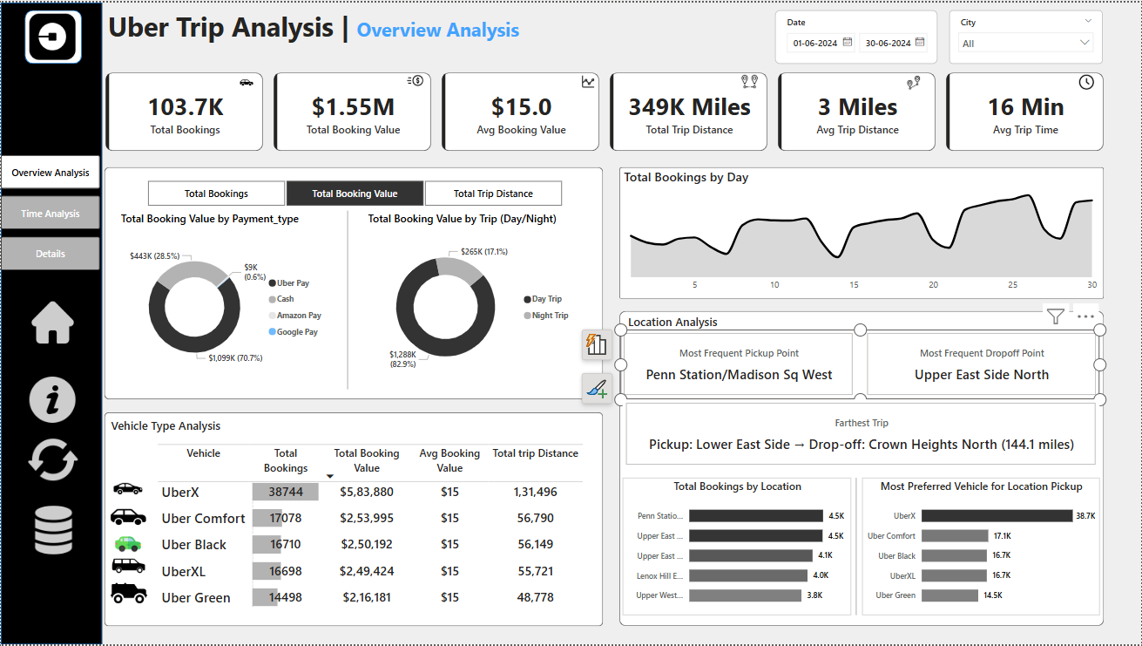
Uber Trip Analysis Dashboard

Slide 7
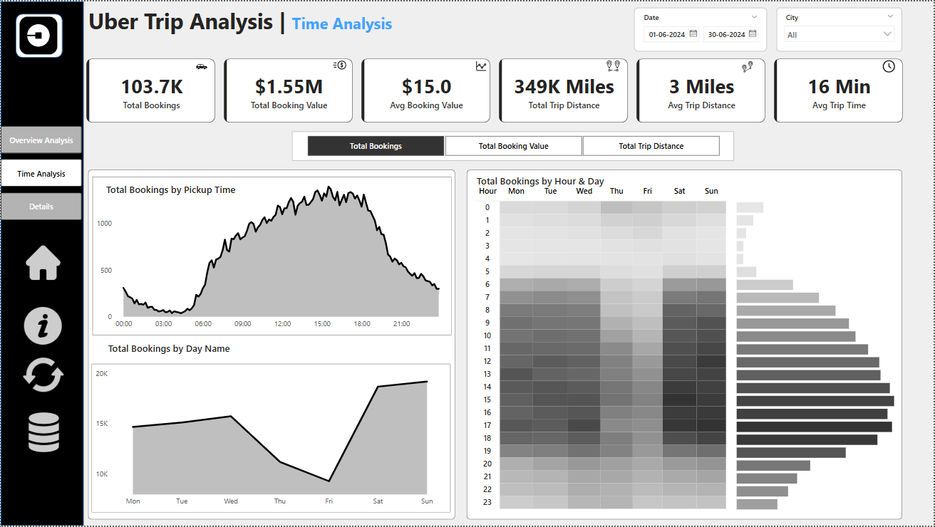

Slide 8
